Slide 1
TINE Core Meeting
26.4.2016

Slide 2
Noteworthy C-Lib Changes
Bug fix concerning poll() behavior.
MCA format elevation
Bug fix on MACOS (from last time)

Slide 3
select() vs. poll()
Up to August 2015 TINE made use of select().
int select(int nfds, fd_set *readfds, fd_set *writefds,
fd_set *exceptfds, struct timeval *timeout);
void FD_CLR(int fd, fd_set *set);
int FD_ISSET(int fd, fd_set *set);
void FD_SET(int fd, fd_set *set);
void FD_ZERO(fd_set *set);
RETURN VALUE
On success, select() and pselect() return the number of file descriptors contained in the three returned descriptor sets (that is, the total number of bits that are set in readfds, writefds, exceptfds) which may be zero if the timeout expires before anything interesting happens. On error, -1 is returned, and errno is set appropriately; the sets and timeout become undefined, so do not rely on their contents after an error.
ERRORS
EBADF An invalid file descriptor was given in one of the sets. (Perhaps a
file descriptor that was already closed, or one on which an error has
occurred.)
EINTR A signal was caught; see signal(7).
EINVAL nfds is negative or the value contained within timeout is invalid.
ENOMEM unable to allocate memory for internal tables.

Slide 4
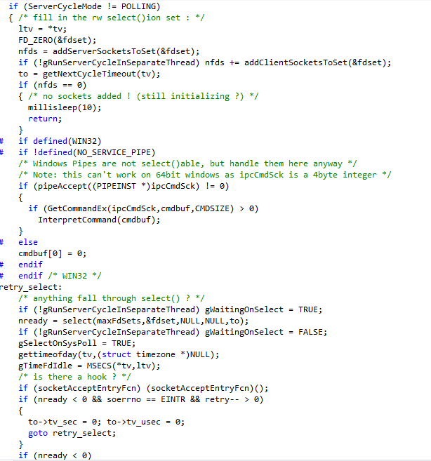
select() vs. poll()
in routine AcceptIP() in srvip.c
put all socket descriptors in the set
just select on ‘read sets’ !
“The mother of all select()s” – S. Herb

Slide 5
The doocs server with >1024 open files problem :
XFEL Magnet Middle Layer Server (L. Froehlich) written as a doocs server with TINE thread.
Collects info from all 1200+ Magnet PSCs in XFEL.
Keeps a doocs history of each one individually.
doocs histories keep files open!
Then turns on the TINE thread
Initial socket descriptor tries to begin at > 1200.
select() is limited to 1024
Oops!

Slide 6
Solutions …
Don’t do it this way (?).
Switch to the more modern ‘poll()’ call.
select() is a BSD standard since the 70s and 80s.
poll() does not exist on all platforms: missing on e.g.Windows XP and VxWorks
int poll(struct pollfd *fds, nfds_t nfds, int timeout);
struct pollfd {
int fd; /* file descriptor */
short events; /* requested events */
short revents; /* returned events */
};
RETURN VALUE
On success, a positive number is returned; this is the number of structures which have nonzero revents fields (in other words, those descriptors with events or errors reported). A value of 0 indicates that the call timed out and
no file descriptors were ready. On error, -1 is returned, and errno is set appropriately.
ERRORS
EFAULT The array given as argument was not contained in the calling program's address space.
EINTR A signal occurred before any requested event; see signal(7).
EINVAL The nfds value exceeds the RLIMIT_NOFILE value.
ENOMEM There was no space to allocate file descriptor tables.
POLLIN
There is data to read.
POLLPRI
There is urgent data to read (e.g., out-of-band data on TCP
socket; pseudoterminal master in packet mode has seen state
change in slave).
POLLOUT
Writing now will not block.
POLLRDHUP (since Linux 2.6.17)
Stream socket peer closed connection, or shut down writing half
of connection. The _GNU_SOURCE feature test macro must be
defined (before including any header files) in order to obtain
this definition.
POLLERR
Error condition (output only).
POLLHUP
Hang up (output only).

Slide 7
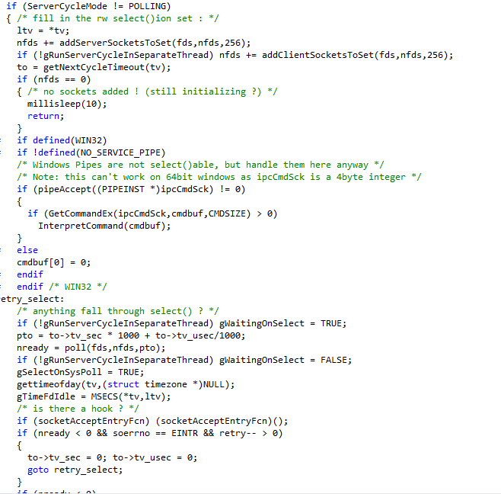
Solution with poll() in August 2015
put all socket descriptors in the set
just look for POLLIN !
“The mother of all poll()s”
Can anyone spot the bugs ?

Slide 8
Recent Problems …
CFEL:
Using TCP, client disconnects and server consumes 100% for up to 5 minutes.
EMBL:
tineRepeater occasionally gets into a mode where it uses 100% CPU (and stays there until restarted).
????

Slide 9
Bugs with poll() since August 2015
put all socket descriptors in the set
These routines now take an offset !
just look for POLLIN !
Poll() always (!) fills in the exceptions in .revents and then does NOT return -1 with EINTR but returns a ready count > 0!
“The mother of all poll()s”

Slide 10
MCA Format Elevation
A property can register itself to deliver a ‘multi-channel array’ (MCA).
e.g. property “Orbit.X” (all BPM positions), “Pressure” (all ion pumps), “Temperature” (all temperature sensors)
More efficient to get an array of all 300 monitors than to get 300 individual elements !
A “proper” MCA property will be able to deliver
a value for a single requested device, (scalar)
a set of values for a section, or (array)
all values for all devices. (array)
Monitoring a single device will ‘coerce’ the requested contract into obtaining the entire array and piping the proper array element into the original request.
The server sees and handles only a single contract for all devices on behalf of ALL interested parties.

Slide 11
MCA Format Elevation
The Issue:
What if device ‘B’ (e.g. element #15) has a problem (e.g. ‘hardware error’)?
Either the whole MCA has a problem (‘hardware error’) or the whole MCA is ‘okay’ (and the data for element #15 ?).
Josef’s server wizard takes the first strategy.
New Approach:
Format elevation !
If a property “P” is registered to deliver an MCA of FLOAT values AND is overloaded to deliver an MCA of FLTINT values (value-status pairs) then the MCA coercion is allowed to ‘elevate’ a request for FLOATs to a request for FLTINTs.
The original request sees the FLOAT value and the INT status.

Slide 12
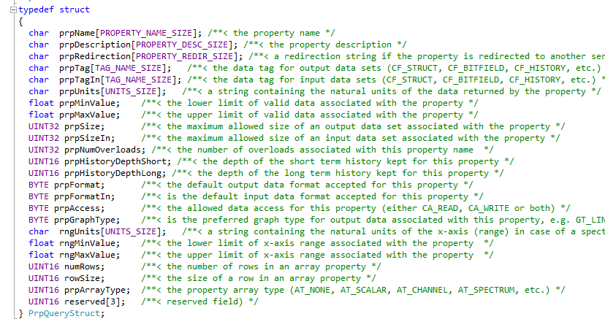
MACOS Bug Fix (from last time)
MACOS (FreeBSD) doesn’t like in-situ memcpy() (overlapping memory areas).
e.g. Prepare an array of ‘PrpQueryStruct’ items

Slide 13
MACOS Bug Fix (from last time)
Caller just wants an array of NAME64 items (64-character fixed length strings).
Should work just fine if ‘names’ and ‘prpQueryStructs’ point to the same memory area …
MACOS doesn’t like this …
for (i=0; i<length; i++) memcpy(names[i],prpQueryStructs[i].prpName,64);

