Slide 1
TINE Core Meeting
17.4.2018

Slide 2
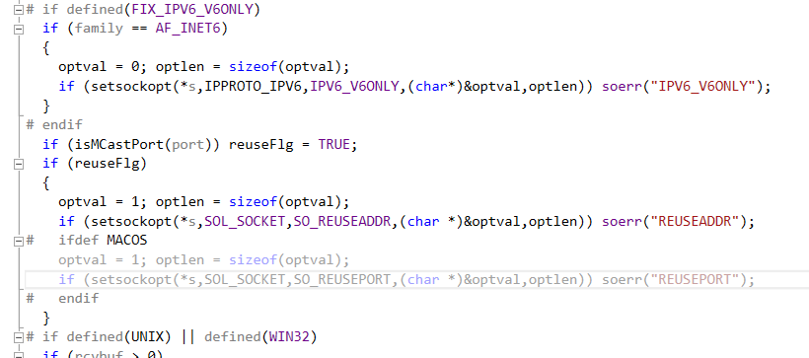
4.6.3
Modern Windows, Linux, MACOS know about option IPV6_V6ONLY
Ipv6 residue ...
legacy Windows, Solaris, VxWorks
…
In prolog.h

Slide 3
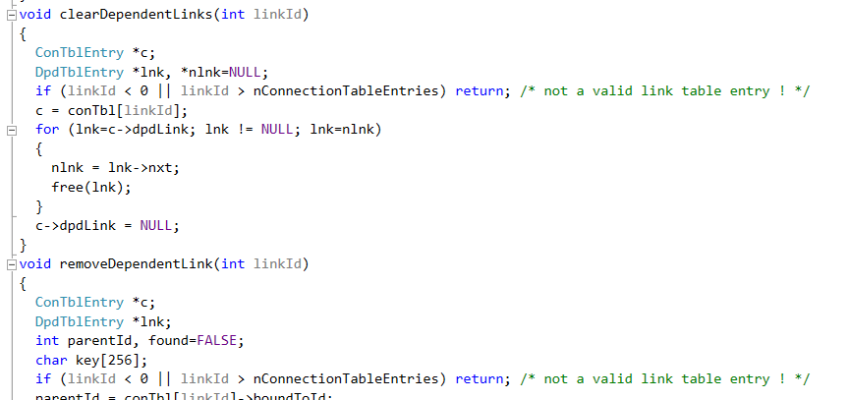
4.6.3 Fixes and Features…
Some memory leaks …
Certain scenarios involving dependent links …
(multiple calls to the ‘same thing’)

Slide 4
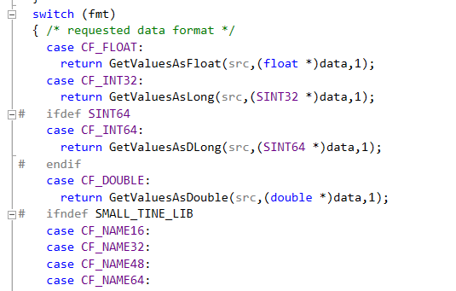
4.6.3 Fixes and Features…
In
-> missing data type CF_INT64 (Arthur):
int getFormattedHistoryDataPoint(DTYPE *dst,DTYPE *src)

Slide 5
4.6.3 Fixes and Features…
CF_INT16 etc. vs. CF_UINT16 etc. ?
As yet: TINE like Java -> no explicit ‘unsigned’
Interpret as you like …
Utilities from toolkit.c :
Should we introduce explicit ‘strong’ format identifiers ?
CF_UINT16, CF_UINT32, CF_UINT64
useful in property registration ?

Slide 6
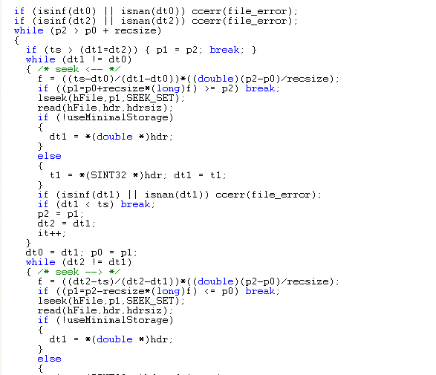
Infinity …
Central Archive Server
Searching for a value …
read timestamp dt2 as ‘inf’ (i.e. 0x7ff000000)
gets lost in lseek() !

Slide 7
4.6.3 Fixes and Features…
Include same check in local history routines …
Modern OSes know about ‘isinf(v)’ and ‘isnan(v)’ but of course some don’t …
Older Windows (use ‘_isnan(v)’ and ‘!isfinite(v)’)
Solaris (use ‘!isfinite(v)’)
VxWorks doesn’t need it ! (no file system)

Slide 8
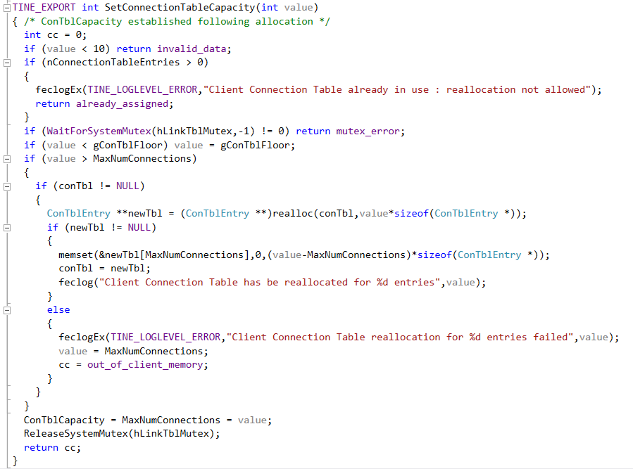
Bug-fix of the month …
new!
can be problematic !

Slide 9
Bug-fix of the month …
Work-around solution for Lars :
or :
Table capacity no allowed to be less than gConTblFloor !

Slide 10
Bug-fix of the month before …
Thanks to an Acop.NET application …
CloseLink(int linkId)
Scenario:
Component A has a real MCA link over all devices (e.g. bunch currents) and uses a bound data reference.
Component B has a single-element of same MCA link (e.g. a trend of one of the bunches)
Either B owns the MCA link and A attaches to B or A owns the link and B attaches to A
A Detaches its link and frees its data.
B crashes and burns … (if A owns the link!)

Slide 11
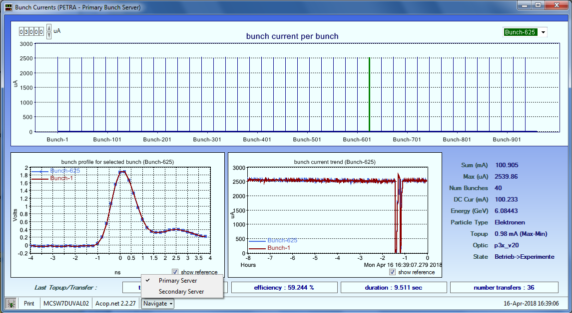
Bug-fix of the month before …

Slide 12
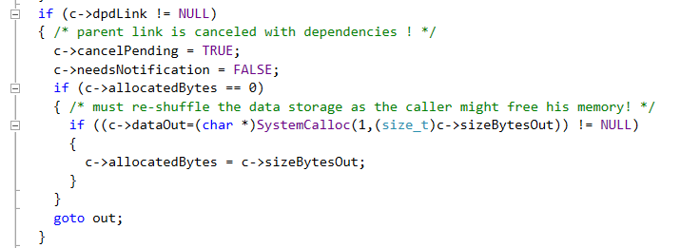
Bug-fix of the month before …
If the ‘owner’ closes and is using its own memory then allocate a parallel data set !
inside _closeLink() :

Slide 13
4.6.3 and IPv6
Both C and Java code are IPv6 ready!
Acop.NET news ?
New bells and whistles …
3-D plots in AcopChart?

Slide 14
Release 5.0
Release 5.0 …
http://adweb.desy.de/mcs/TINE_Presentations/CollaborationMeeting2012/CollaborationMeeting2012.pdf
Begin with release 5 headers …
extended with more information
String sets: utf8
applies to ‘names, strings that are seen’.
Full compatibility with release 4
worry about release 3?
Queried and registered information …
need extensions?
e.g. a lot of (rather fuzzy) discussions about data mining etc. => property registration to contain more attributes?
e.g. ‘IsDataMineable’

Slide 15
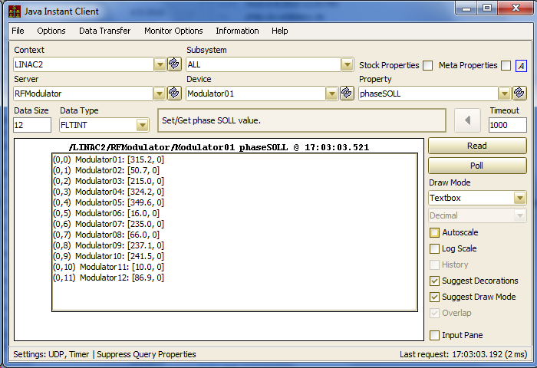
Release 5.0
General To-Do items ?
Automatic overloading of some data types?
e.g. (one of Marcus’ 1st servers …)
phaseSOLL is only registered to deliver data type FLTINT (a data – status doublet)
If the server does not itself overload the property to handle FLOAT we could automatically allow such a call …

