Slide 1
TINE Core Meeting
30.08.2016

Slide 2
Noteworthy Changes (C-Lib and java)
June 12: Allow local histories (and central archive) to keep and return complex data as well as structures.
Make use of new ‘field index’ in the calls:
specify a specific structure/data type ‘field’ to trend on.

Slide 3
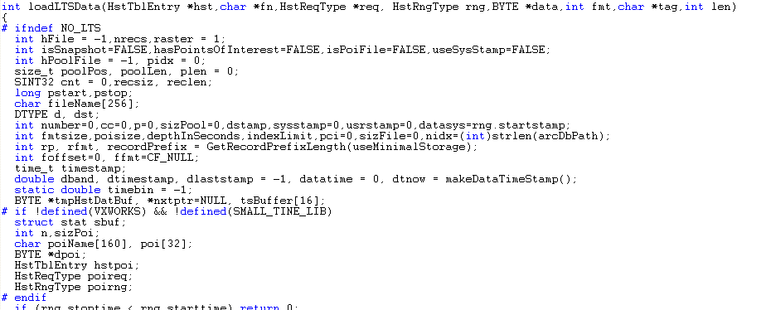
Noteworthy Changes (C-Lib)

Slide 4
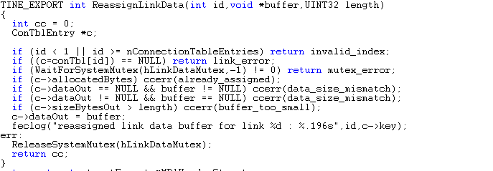
Noteworthy C-Lib changes
June 14: ‘ReassignLinkData()’
Assign new reference for ‘bound data’ in an active Link
For use in rotating buffers …

Slide 5
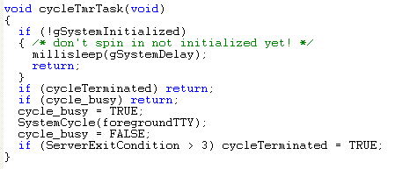
Noteworthy C-Lib changes
July 15: make direct use of ‘foregroundTTY’ in SystemCycle() calls used in tcycler.c.
Established via initial call to SystemInit() or specific API (otherwise ‘FALSE’ => no parsing of std input in the foreground).
Do NOT want to do this in non-GUI Python/MatLab etc.

Slide 6
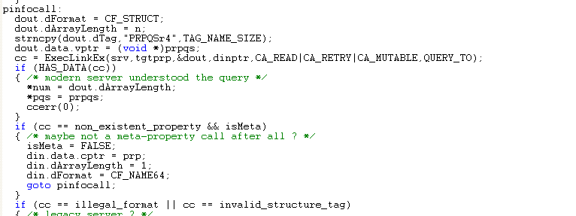
Noteworthy C-Lib changes
June 16: add a ‘retry’ in GetSystemPropertyInformation() to accommodate ‘Meta-Property’ Look-alikes …

Slide 7
Noteworthy C-Lib Changes
July 25: work around the (incredibly stupid) #define timezone in python 3.5 !
#if !defined(UNIX) && !defined(HAVE_GETTIMEOFDAY) around the prototype for gettimeofday !!
prolog.h
pytine.cpp

Slide 8
Noteworthy C-Lib Changes
July 29 (Karol) Attempt to recognize inadvertent aliases.
introduce 'gDieOnFecIsAlias' and Set/Get routines (default = FALSE).
better check on a 'FEC match' in looking for existing link
“ServerB” uses same EQM Name, port and IP address for “FECB” as was formerly used for “ServerA” on “FECA”.
So: “ServerA” answers!
trap problem renegotiating contract back to the normal contract length if the returned data size returns to 'normal'.

Slide 9
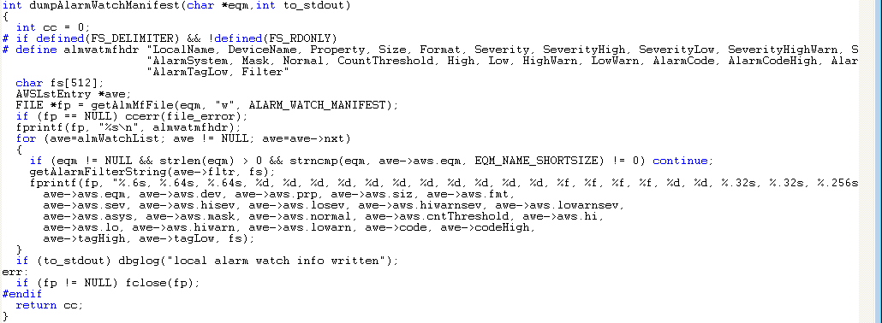
Noteworthy C-Lib Changes
Alarm Manifests a la History Manifests …
Regardless of ‘how registered’ (API or config file) a manifest of the current alarm and alarm watch information is dumped to file a short while after a server start.
Option to suppress the ‘dump message’ to std out.
(doocs ‘log’ files).

Slide 10
Noteworthy C-Lib Changes
Alarm-specific Filters !
Previously: only applicable to ‘watched’ alarms.
almlib.h

Slide 11
Noteworthy C-Lib Changes
Clear the immediate partner in a watch table alarm if the value slides from e.g. 'warning' to 'real'.
Automatic ‘file_error’ alarms if
Log files cannot be written
Local history files cannot be written.

Slide 12
Noteworthy C-Lib Changes
Property Handlers (a la java servers)
In addition to or in lieu of the standard equipment module dispatch handler.
Internal equipment module for simple cases.
TODO: ‘stock’ handlers for e.g. attribute properties or commands.

Slide 13
Noteworthy C-Lib Changes
Other Bug Fixes:
Check for ‘overloaded properties’ when acquiring a ‘property list structure’.
Ensure that overloaded properties ‘replicate’ common information.
Repair ‘save-and-restore’ when non-WRITE overload property registered.
Lars: added ‘CA_NOCALLBACKS’ for use in ExecLink()
Turns off callbacks during the synchronous execution of this call.
Issue: ‘replace’ e.g.
#define out_of_range 37
with
const int out_of_range = 37;
???

Slide 14
Still To Do …
how to get and display and set (?) the alarmwatch and history filters
=> work with 'parseable' strings
=> stock property (command line also) “ALMFILTERS” (get/set almfilters)
input/output: alarm code and filter string
---> a new 'struct' (int and 256 char string) or CF_KEYVALUE (with CODE:val and FILTER:parseable string as alternating entries ?)
or: CF_STRING (with CODE:val FILTER:string) (list of atomic strings)
read: get watchtable and specific alarm filters
write: apply/edit filter for watchtable or specific alarm (first check if the target alarm is being 'watched' -> apply to watchtable; else apply to specific alarm definition)
=> stock property (command line) “HSTFILERS” (get/set hstfilters)
read: get local history filters
write: apply/edit filter for local history entry

Slide 15
Still To Do …
console command to mkhstfiles (on separate thread)
console commands to change history or alarm settings on the fly
stock handlers
local history:
add 'CF_STRUCT' + tag to the API
unix PIPE -> socket gets a 'temporarily unavailable' error !
errors.log ? a la 'commands.log‘

Slide 16
Still To Do …
IPv6 testing
Release 5.0 …

