Slide 1
TINE Core Meeting
2.8.2018

Slide 2
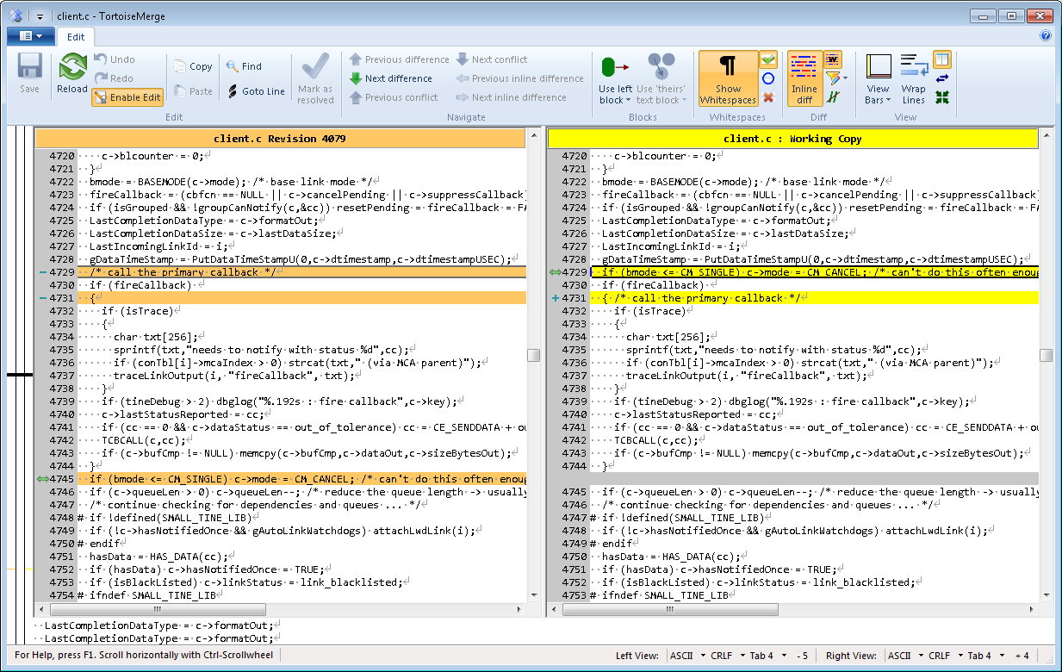
4.6.3 Fixes and Features…
In NotifyClient() (client.c) :
  Unit stress test failing with too many link timeouts (TCP/STREAM mode)

Slide 3
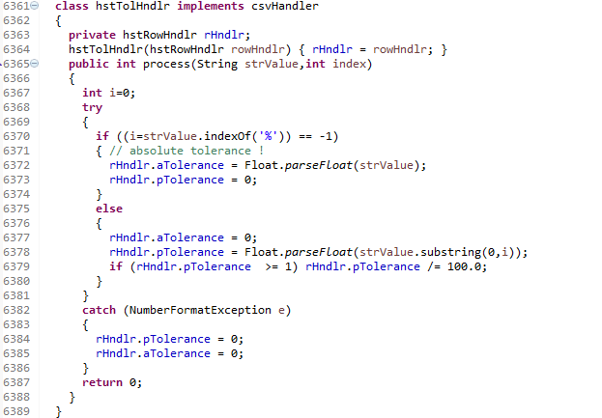
4.6.3 Java
  Local History relative tolerance.

Slide 4
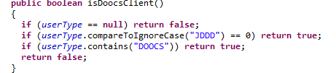
4.6.3 Java
TLinkFactory.userType (String)
  In advance of Release 5.0 :
  => jddd Workarounds only apply to actual jddd clients !

Slide 5
Odds and Ends
Tutorials
  Interest in tutorials (Python, Acop.NET, ?)
Acop.NET News
  AcopForm, 3-D charts, etc.
  PCaPAC presentation as early alpha @ Wednesday meeting in a few weeks; as beta @ TINE Users Meeting in September …
Central Archive News:
  Master/Slave role reversals …
    PETRA, XFEL
    Coming soon: anybody else?

Slide 6
Release 5.0
Release 5.0 …
  Preliminary versions (C and Java) in SVN.
  C Unit Client and Servers tested (with even more tests!)
    R5 server – R5 client
    R5 server – R4 client
    R4 server – R5 client
  Java server and clients tested
    No ‘java unit server’
    Numerous unit tests by hand …

Slide 7
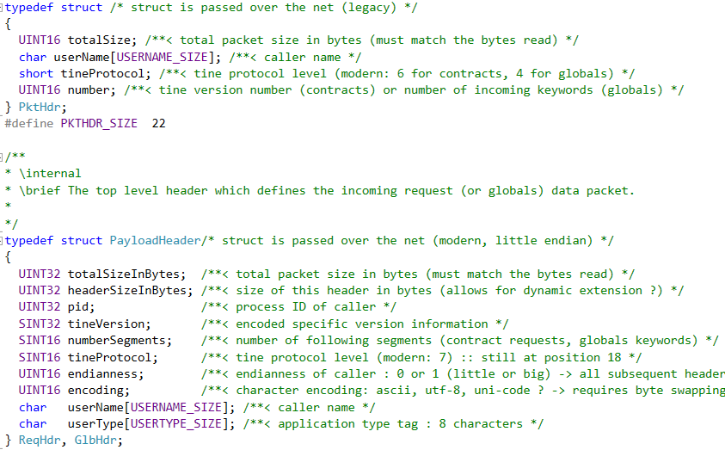
Release 5.0 Transport headers

Slide 8
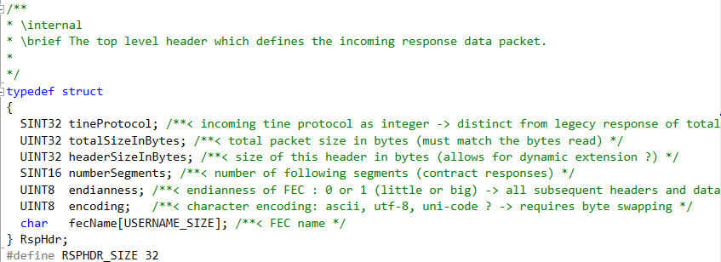
Release 5.0 Transport headers
Response (Server -> Client)
  Legacy: just single unsigned short with sizeInBytes …
  Modern:

Slide 9
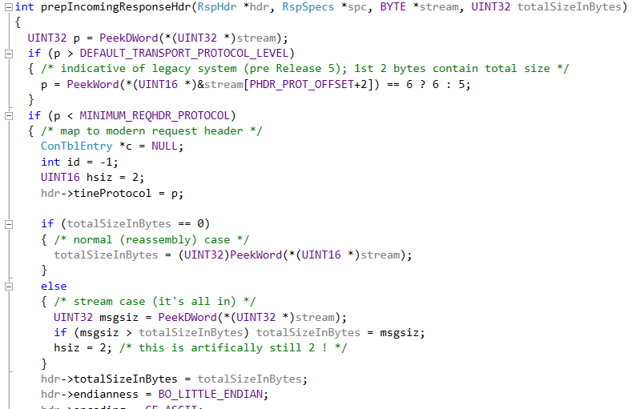
Release 5.0 Transport headers
Handling legacy responses :

Slide 10
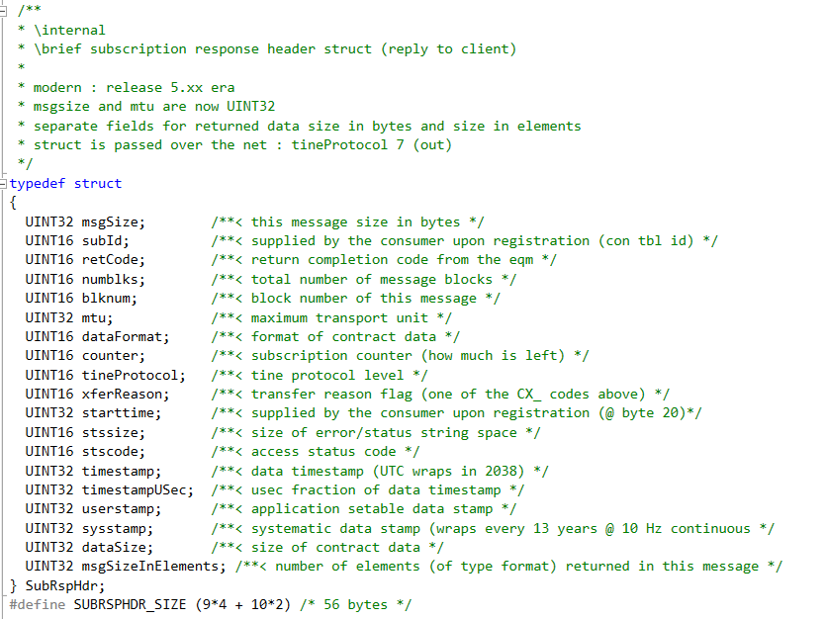
Release 5.0 Transport headers
Subscription header(s) follow the Response header:
sysstamp and userstamp still 32-bit integer and NOT 64-bit integer.

Slide 11
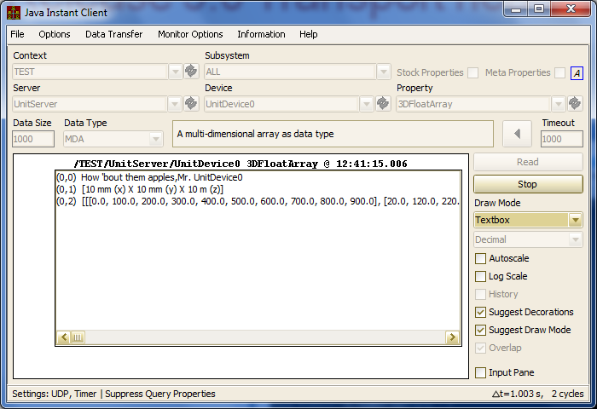
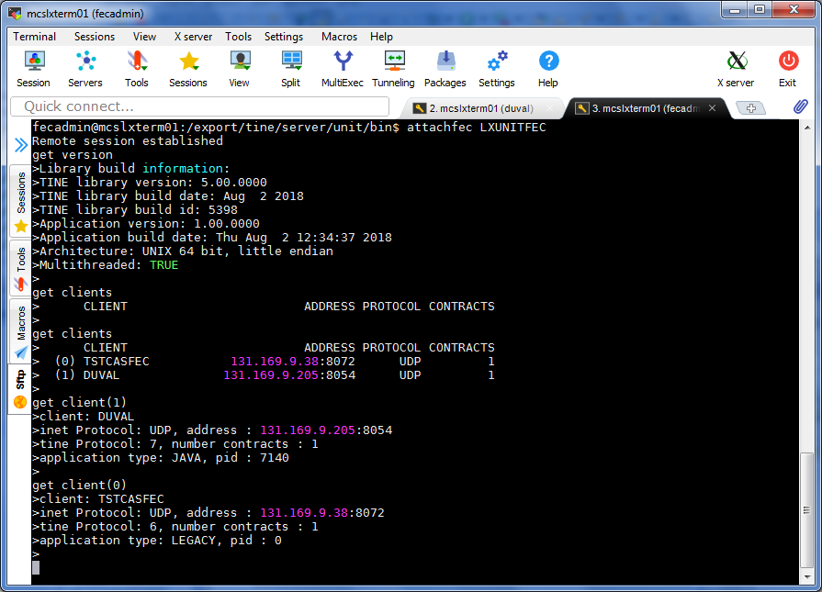
Release 5.0 Transport headers
Release 5 java client
Release 5 C server …

Slide 12
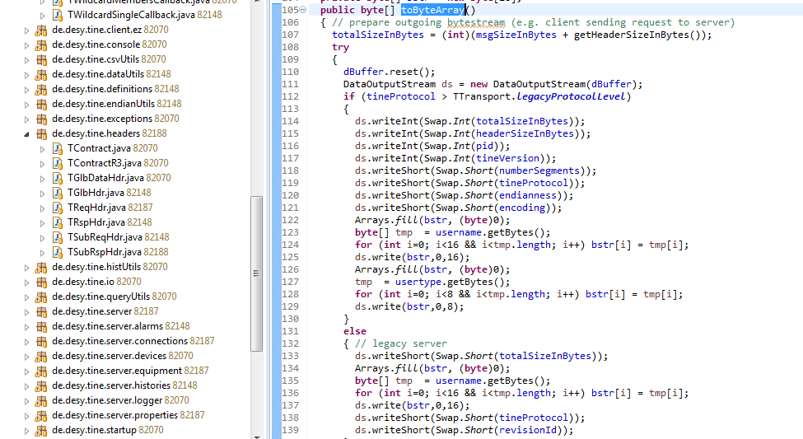
Release 5.0 Transport headers
Java: same transport headers and compatibility must be present!

Slide 13
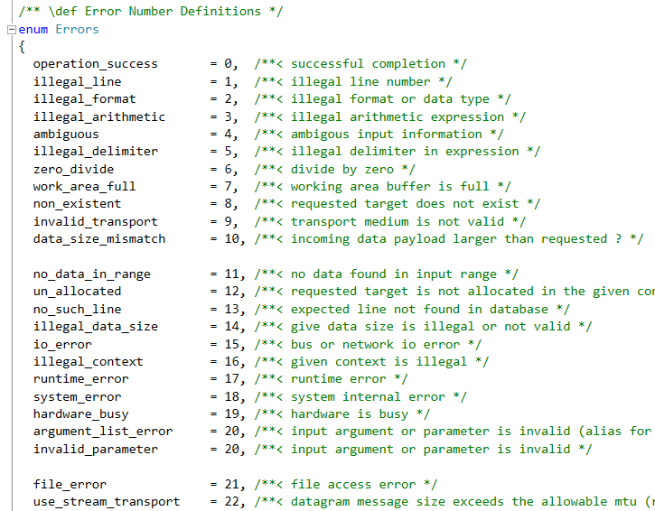
Release 5.0 Transport headers
Other embellishments …
C side:
  Many macro #defines (which have been around since ‘the beginning’) have moved to enums
  Many macros -> functions
    Forget about being nice to MS-DOS !

Slide 14
Release 5.0 Transport headers
C Side:
  No more clashes with STL or MFC headers !
  Works with or without namespace wrapper
  namespace tine
  {
  #include “tine.h”
  }

Slide 15
Release 5.0 Transport headers
C and Java:
  New format types for strong typing:
    CF_UINT16
    CF_UINT32
    CF_UINT64
  Auto-grow the connection table by default.
  Not yet making use of the endianness or encoding information.

