Slide 1
Win7 UDP Performance Internals
End to End Gigabit Ethernet IPv4 Networking
TINE multicast, unicast
Application: live video transport
Stefan Weisse
DESY IT/Controls
Zeuthen
TINE Core Meeting, December 2016

Slide 2
Win7 UDP Performance Internals Overview
What is possible? (MB/s)
How one can achieve that?
What has shown to fail in practice? (how one can not achieve that)
Reproduce cases on Testbed with two hosts:
host znpfg5: sender with a dedicated GigE camera
host znpfg3: receiver
both hosts monitored via Microsoft Remote Desktop Connection (RDP)!

Slide 3
Win7 UDP Performance Internals Network Setup

Slide 4
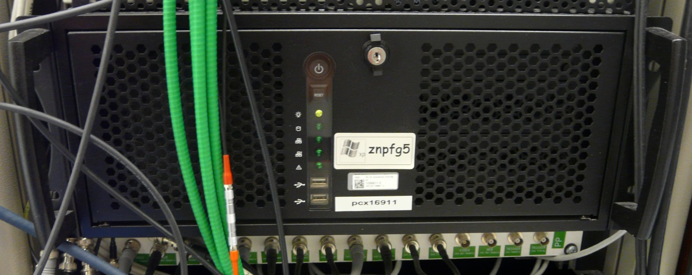
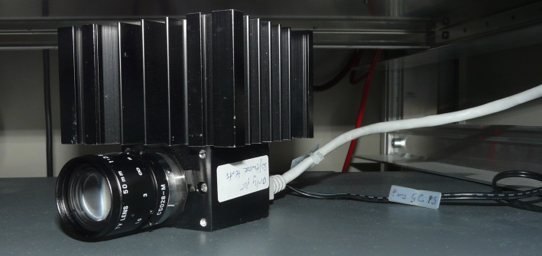
Win7 UDP Performance Internals Host Details
Sender’s system specs:
Hostname: znpfg5
CPU: Intel Core 2 Duo E8400: 3.0 GHz, 2 cores
Motherboard: Intel DX38BT
8 GB RAM (Non-ECC)
Windows 7 64-bit Enterprise (DESY: Firewall and Virus Scanner enabled)
Intel 82566DC-2 Gigabit Network Connection (on-board): DESY LAN
Intel Gigabit CT Desktop Adapter (PCIe x1) : Camera Input (via 1:1 Cable to Camera)

Slide 5
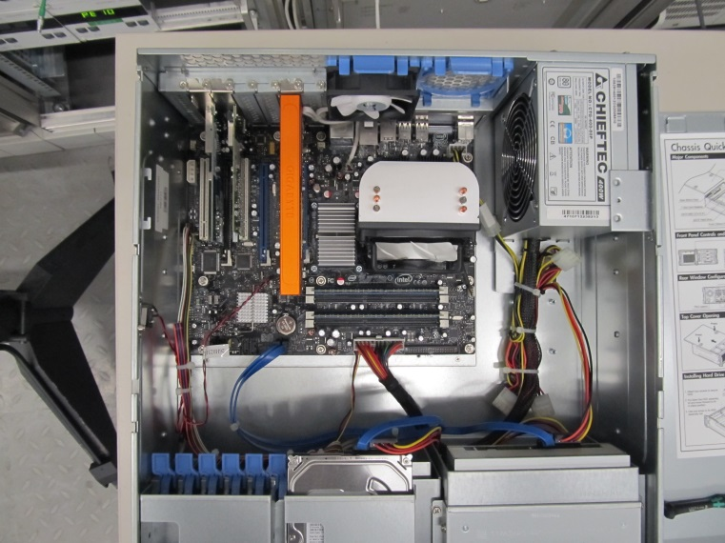
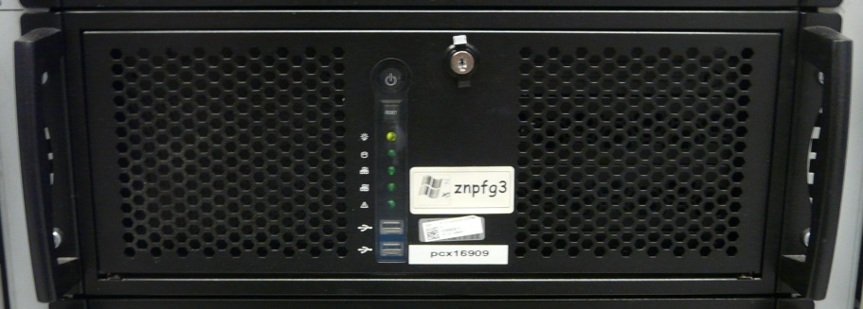
Win7 UDP Performance Internals Host Details
Receiver’s system specs:
Hostname: znpfg3
CPU: Intel Core 2 Duo E8400: 3.0 GHz, 2 cores
Motherboard: Intel DX38BT
4 GB RAM (Non-ECC)
Windows 7 64-bit Enterprise (DESY: Firewall and Virus Scanner enabled)
Intel 82566DC-2 Gigabit Network Connection (on-board): DESY LAN
Common off-the-shelf (COTS) Rackmount PC

Slide 6
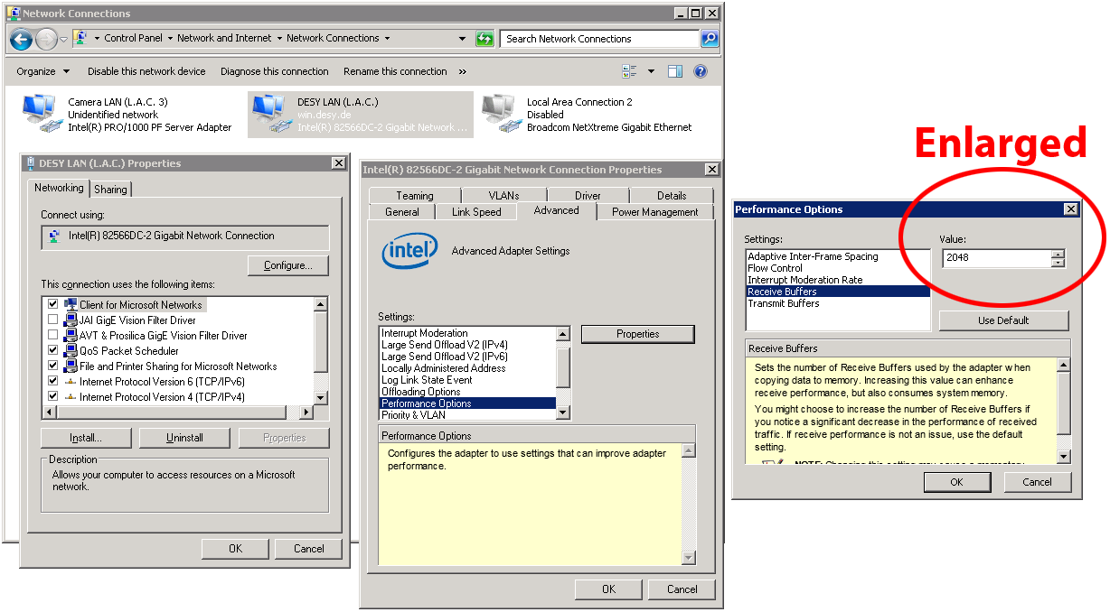
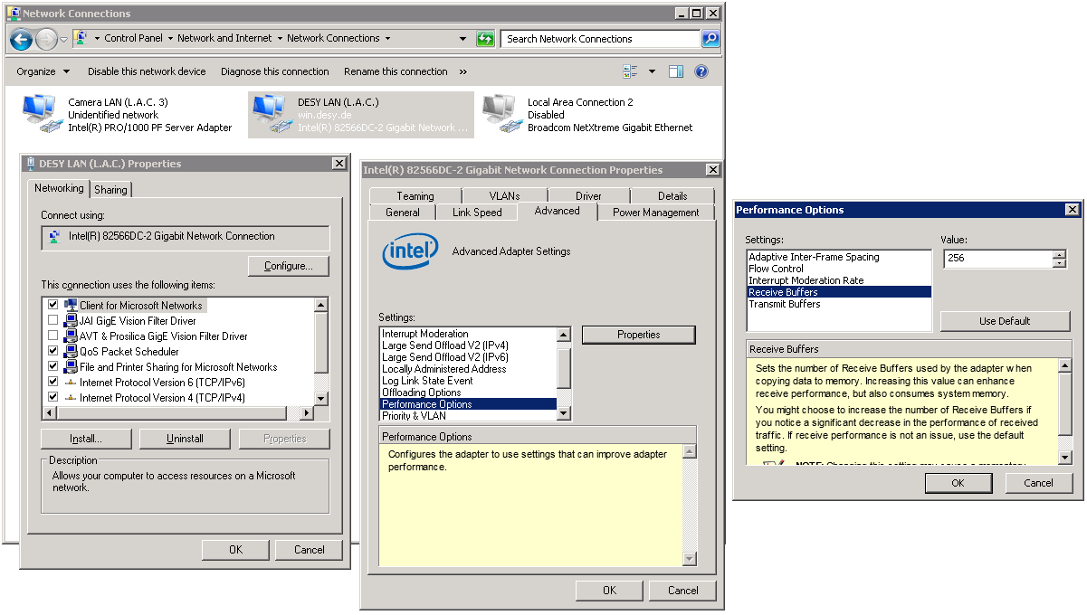
Win7 UDP Performance Internals Host Details
Intel Network Interface Card (NIC) Tuning
Receive Buffers: 256 -> 2048 (max)
When dealing with the high throughput UDP traffic a GigE camera can provide, enlarging receive buffers has shown to improve transport reliability (few dropped packets or dropped frames -> no dropped packets/dropped frames)
According to a test which I’ve done it’s not clear whether increasing number of receive buffers has a positive effect on transfer stability as shown in this presentation
No negative side effects have been observed

Slide 7
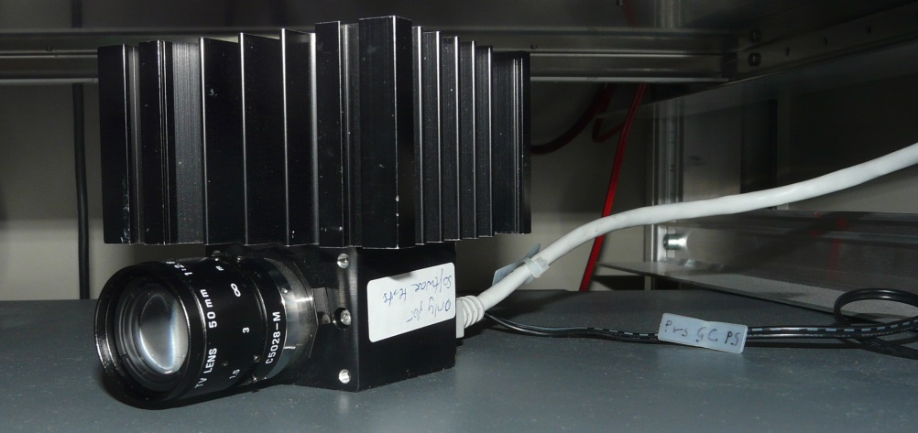
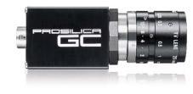
Win7 UDP Performance Internals Image Source Details
Prosilica GC1350M
1360x1024 pixel
Monochrome
12 bits per pixel (as 2 bytes per pixel)
Up to 20 Hz full frame read out (20.065 Hz)
Total possible (net) bandwidth: 53.13 MB/s (55.705.600 bytes per second) (1360 x 1024 x 2 x 20)
As comparison: Highest in practice observed Gigabit Ethernet bandwidth (with TCP): 109 MB/s (NetIO benchmark v1.31)

Slide 8
Win7 UDP Performance Internals Goal
A transfer is very stable if:
Less than 1 per 1000 frames is dropped, for more than 10 minutes

Slide 9
Win7 UDP Performance Internals Settings which are not modified across tests runs
Camera Prosilica GC1350M (connected to znpfg5)
delivering 1360x1024x12 bit -> 2.785.280 bytes / image
TINE server (on znpfg5)
Lazy scheduling
CycleDelay=0
SGP_ProsilicaGigE.exe: C/C++ 32-bit Windows executable, using tine32.dll*
TINE client (on znpfg3)
Multicast, 2000ms polling interval
socket receive buffer: 4.194.304 bytes
TineFrameTransferTestV3.exe: C/C++ 32-bit Windows executable, using tine32.dll*
*: tine32.dll v4.5.10 build 5248 (Jun 16, 2016)

Slide 10
Win7 UDP Performance Internals Bandwidth Demands
1 video frame 1360x1024 pixel, 2 bytes per pixel -> 2.785.280 bytes (2.66 MB)
UDP packet size: 1024 bytes
packets/s: 2720 @ 1 Hz, 27200 @ 10 Hz, 54400 @ 20 Hz
UDP packet size: 1472 bytes
packets/s: 1893 @ 1 Hz, 18930 @ 10 Hz, 37860 @ 20 Hz
UDP packet size: 9000 bytes
packets/s: 310 @ 1 Hz, 3100 @ 10 Hz, 6200 @ 20 Hz
UDP packet size: 16384 bytes
packets/s: 170 @ 1 Hz, 1700 @ 10 Hz, 3400 @ 20 Hz
Not taking into account TINE UDP packet header size!
Rough Estimate!

Slide 11
Win7 UDP Performance Internals Bandwidth Demands
High number of UDP packets require high effort
for each TINE packet, a TINE header is appended, lowering the possible bandwidth (but not much)
a lot of code in TINE is run for each packet, same is true on a lower level for operating system, driver of NIC
CPU is heavily utilized for a huge number of packets per second

Slide 12
Win7 UDP Performance Internals IP fragmentation and reassembly?
Common operating systems (at least non-embedded Linux, Windows) support IP fragmentation and reassembly
Idea: set TINE PacketMTU to a huge number, e.g. 16384, effectively lowering the number of TINE packets that need to be produced, send, received and decoded
TCP/IP firmware across the path will split the big UDP packet into fragments small enough to be transported on the underlying layer, client will reassemble the fragments (if all fragments arrive the client)
Drawback: Not all operating systems support IP fragmentation and reassembly
In principle a promising idea, but in practice…

Slide 13
Win7 UDP Performance Internals IP fragmentation and reassembly??
Transfer specs
2.66 MB/frame, 20 Hz
PacketMTU=16384 bytes, BurstLimit=3, SocketSendBufferKB=64
CycleDelay=0, MicroDelay=100
First observation after starting the transfer:
CPU load is pretty low, transfer is stable at a frame rate which was not expected to be reached (20 Hz -> 53.1 MB/s)
But after some time (usually minutes)….
Transfer starts to drop more and more frames per second
And some time later…
on client, incoming traffic is still present, but no data reaches the client application
eventually, some time later, network load drops to almost zero (multicast traffic stops)

Slide 14
Win7 UDP Performance Internals IP reassembly buffer pool exhaust: Unfreeze Multicast
Stop transfer
Observe Windows Task Manager, that network load is getting low
Wait two minutes
Transfer should be able to be restarted, and should run with little or no data losses
If not then wait five minutes
The above recipe does not always bring back a very stable transfer, even though an improvement is always there
network weather conditions?

Slide 15
Win7 UDP Performance Internals Screencast: transfer break, unfreeze hanging transfer
Video: ip-reassembly-buffer-pool-exhaust-mcast-DenOfSrv-Jul12-2016.mp4 (3m15s, 7.1 MB)
no video frame reaches the client application
in Windows task manager (networking tab), one can see a large network utilization on server as well as client side
netstat*, on client, shows expected high number of fragments incoming (~41000/s)
netstat*, on client, does not show expected number of successful reassemblies (less than 50/s are shown, but more than 3400/s expected)
at 0m51s, the transfer is stopped by hand
one can see in Windows task manager (networking tab) that network load drops almost immediately to zero
at 1m50s, the transfer is restarted
at 2m28s, first frame is dropped
up to the end: frame drops increase, but do not reach fatal level (yet…)
*: netstat -s -p IP -t 1

Slide 16
Win7 UDP Performance Internals IP reassembly failure
IP reassembly is not stable enough at high data rates
IP reassembly buffer exhaust?
Due to UDP fragments not reaching the client, other fragments of the same macropacket block buffer space in the IP reassembly pool, if IP reassembly is successful, buffer space is released quickly, available for new packets as they come in, but if some fragment is missing, other fragments of the same macropacket block space in the IP reassembly pool for seconds to minutes ([technet], [rfc2460], [rfc791])
Reassembly fragment number only 16 bit?
reassembled macroblock checksum mismatch? [rfc4963]
[technet] http://blogs.technet.com/b/nettracer/archive/2010/08/10/3335600.aspx
[rfc2460] http://www.ietf.org/rfc/rfc2460.txt
[rfc791] http://www.ietf.org/rfc/rfc791.txt
[rfc4963] http://www.ietf.org/rfc/rfc4963.txt

Slide 17
Win7 UDP Performance Internals IP reassembly buffer pool exhaust
As far as I know
Limited possibilities to trace IP reassembly buffers (statistics)
No possibilities to tweak the pool (e.g. adjust timeout, enlarge buffer space)
If the bandwidth demand is low, no issue has been observed
Multicast 3.66 MB/s (1600x1200x2 byte per pixel at 1 Hz) in Hamburg @ PETRA
But if bandwidth demand is high, sooner or later degrading of transfer stability has been observed, even though it’s not clearly reproducable
dependency on overall network load?
also dependency on client network load suspected
at 5 Hz (13.28 MB/s): no issue observed (running for more than two days)
at 7 Hz (18.59 MB/s): issue reproduced (took more than 20 hours until fatal)

Slide 18
Win7 UDP Performance Internals Maximum fragment-free UDP Packet Size?
If going high bandwidth, IP fragmentation and reassembly looks like no way to go right now…
as a consequence, TINE needs to operate on small packet size, which puts high demand on CPU
modern desktop CPUs (Haswell, Skylake, especially 4+-core) are supposed to handle this, but 5 year old Core 2 Duo may not
What’s the maximum UDP packet size which is not fragmented? (no fragmentation and reassembly while retaining lowest possible number of packets per second)
in general, on LAN, 1472 bytes is a good guess

Slide 19
Win7 UDP Performance Internals Maximum fragment-free UDP Packet Size
C:\Windows\System32>ping /?
Usage: ping [-t] [-a] [-n count] [-l size] [-f] [-i TTL] [-v TOS]
[-r count] [-s count] [[-j host-list] | [-k host-list]]
[-w timeout] [-R] [-S srcaddr] [-4] [-6] target_name
Options:
-t Ping the specified host until stopped.
To see statistics and continue - type Control-Break;
To stop - type Control-C.
-a Resolve addresses to hostnames.
-n count Number of echo requests to send.
-l size Send buffer size.
-f Set Don't Fragment flag in packet (IPv4-only).
-i TTL Time To Live.
-v TOS Type Of Service (IPv4-only. This setting has been deprecated
and has no effect on the type of service field in the IP Header).
-r count Record route for count hops (IPv4-only).
-s count Timestamp for count hops (IPv4-only).
-j host-list Loose source route along host-list (IPv4-only).
-k host-list Strict source route along host-list (IPv4-only).
-w timeout Timeout in milliseconds to wait for each reply.
-R Use routing header to test reverse route also (IPv6-only).
-S srcaddr Source address to use.
-4 Force using IPv4.
-6 Force using IPv6.

Slide 20
Win7 UDP Performance Internals Maximum fragment-free UDP Packet Size
[znpfg3] C:\temp\sweisse\netio>ping -l 1472 -f znpfg5
Pinging znpfg5.ifh.de [141.34.30.215] with 1472 bytes of data:
Reply from 141.34.30.215: bytes=1472 time<1ms TTL=128
Reply from 141.34.30.215: bytes=1472 time<1ms TTL=128
Ping statistics for 141.34.30.215:
Packets: Sent = 2, Received = 2, Lost = 0 (0% loss),
Approximate round trip times in milli-seconds:
Minimum = 0ms, Maximum = 0ms, Average = 0ms
Control-C
^C
[znpfg3] C:\temp\sweisse\netio>ping -l 1473 -f znpfg5
Pinging znpfg5.ifh.de [141.34.30.215] with 1473 bytes of data:
Packet needs to be fragmented but DF set.
Packet needs to be fragmented but DF set.
Packet needs to be fragmented but DF set.
Ping statistics for 141.34.30.215:
Packets: Sent = 3, Received = 0, Lost = 3 (100% loss),
Control-C
^C
[znpfg3] C:\temp\sweisse\netio>ping -l 1472 -f znpfg5
Pinging znpfg5.ifh.de [141.34.30.215] with 1472 bytes of data:
Reply from 141.34.30.215: bytes=1472 time<1ms TTL=128
Reply from 141.34.30.215: bytes=1472 time<1ms TTL=128
Reply from 141.34.30.215: bytes=1472 time<1ms TTL=128
Ping statistics for 141.34.30.215:
Packets: Sent = 3, Received = 3, Lost = 0 (0% loss),
Approximate round trip times in milli-seconds:
Minimum = 0ms, Maximum = 0ms, Average = 0ms
Control-C
^C

Slide 21
Win7 UDP Performance Internals First non-fragmented transport: low max. bandwidth
Using maximum packet size without fragmentation (1472 bytes)
Maximum achievable bandwidth is unexpected slow (17 MB/s)… why?

Slide 22
Win7 UDP Performance Internals Out of the box: Poor UDP performance

Slide 23
Win7 UDP Performance Internals Registry Settings
HKLM\SYSTEM\CurrentControlSet\services\AFD\Parameters
FastCopyReceiveThreshold
REG_DWORD
Default: 1024 (0x400)
Recommended: 1500 (0x5dc)
little impact on receive assumed
FastSendDatagramThreshold
REG_DWORD
Default: 1024 (0x400)
Recommended: 1500 (0x5dc)
huge impact on send

Slide 24
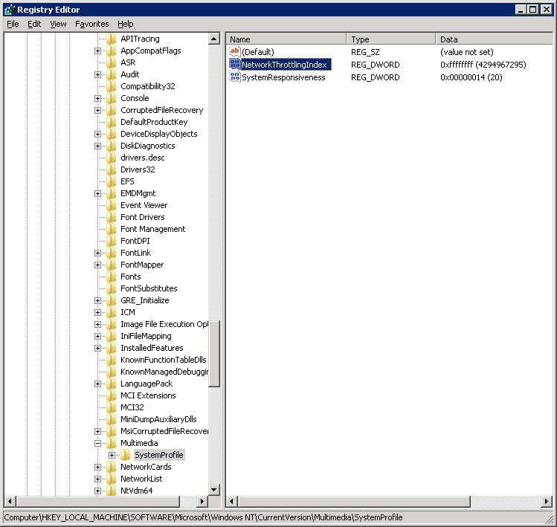
Win7 UDP Performance Internals Registry Settings
HKLM\SOFTWARE\Microsoft\Windows NT\CurrentVersion\Multimedia\SystemProfile
NetworkThrottlingIndex
REG_DWORD
Default value: 0xa
Recommended: 0xffffffff (4294967295)
Impact unknown
In general: No negative side-effects observed.

Slide 25
Win7 UDP Performance Internals Optimized UDP performance

Slide 26
Win7 UDP Performance Internals Win 7 Standard Settings: What’s possible
Camera Framerate 11.0 Hz (29.22 MB/s)
TINE Server: PacketMTU=1024, BurstLimit=30, MicroDelay=10, default SocketSendBufferSize=32 KB
Result: less than 1 per 1000 frames dropped (runtime 15m19s: 10102 frames rcvd, 6 dropped )
In comparison: 12.2 Hz (32.41 MB/s) results in 3 per 1000 frames dropped (13m47s: 10059 frames rcvd, 31 dropped)
Main bottleneck assumed: CPU load (on server and on client around 50% on dual-core machine)

Slide 27
Win7 UDP Performance Internals Win 7 Performance Settings: What’s possible
Camera Framerate 15.5 Hz (41.2 MB/s)
TINE Server: PacketMTU=1472, BurstLimit=21, MicroDelay=10, default SocketSendBufferSize=32 KB
Result: less than 1 per 1000 frames dropped (runtime 10m54s: 10119 frames rcvd, 9 dropped )
In comparison:
16.0 Hz (42.5 MB/s) results in 1.8 per 1000 frames dropped (10m49s: 10350 frames rcvd, 19 dropped)
16.5 Hz (43.8 MB/s) results in 4 per 1000 frames dropped (10m21s: 10213 rcvd, 40 dropped)
Main bottleneck assumed: CPU load (on server and on client around 50% on dual-core machine)

Slide 28
Win7 UDP Performance Internals Win7 Performance vs. Standard (video transmission)
Camera Framerate
Standard: 11.0 Hz (29.22 MB/s)
Performance: 15.5 Hz (41.2 MB/s)
+11.95 MB/s
Both Standard and Performance suffer from busy CPU (higher network bandwidth occupation on less busy CPU expected)

Slide 29
Win7 UDP Performance Internals Summary
Out of the box, UDP bandwidth of packet size >1024 bytes surprisingly low
IP reassembly showed denial of service in real world environment
In wide field: stick to Win7 standard settings, re-adjust TINE to PacketMTU=1024, keep transfer rate low (20 MB/s, maybe 25 MB/s)
In lab: consider windows 7 performance settings, use TINE default PacketMTU=1472, a transfer rate of 40 MB/s is possible
MicroDelay can be used as a handbrake to saturate possible TINE bandwidth before network level issues occur
TINE Send buffer should be kept at default size (32 KB)
on receive side, enlarging of socket buffer is highly recommended (rule of thumb: 1 video frame should fit in receive socket buffer)

Slide 30
Win7 UDP Performance Internals
Thank you for your attention!
Question? Comments?
Remarks?

