Slide 1
TINE Core Meeting
23.1.2018

Slide 2
4.6.3
default HISTORY_HOME is now the subdirectory ‘HISTORY’ under the FEC_HOME directory …
  existing HISTORY files moved if HISTORY_HOME is not otherwise set.
  GetLastStoredData() – normally only used internally - now supports most data types.
collapsed Alarms now terminate properly on a java server.

Slide 3
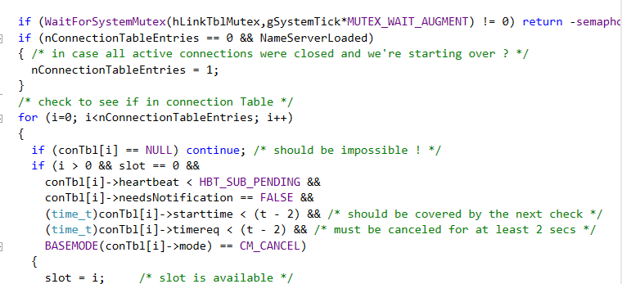
Bug-fix of the month …
Archiver : ‘Reset Server’ (called by DBM) cleans out the current connection table, reloads the database and ‘starts over’ …
And it set nConnectionTableEntries = 0 !

Slide 4
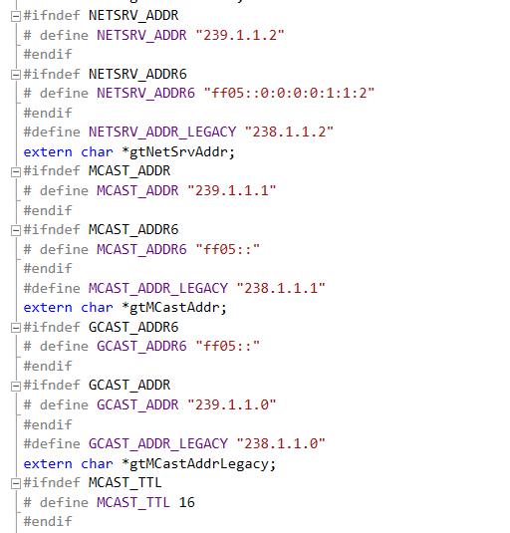
4.6.3 and IPv6
Much testing and tweaking …
Works fine!
  UDP6, TCP6, STREAM6, Multicast …
New environment variable TINE_IPV6
  for testing …
Dual Stack :
  two ways to go …

Slide 5
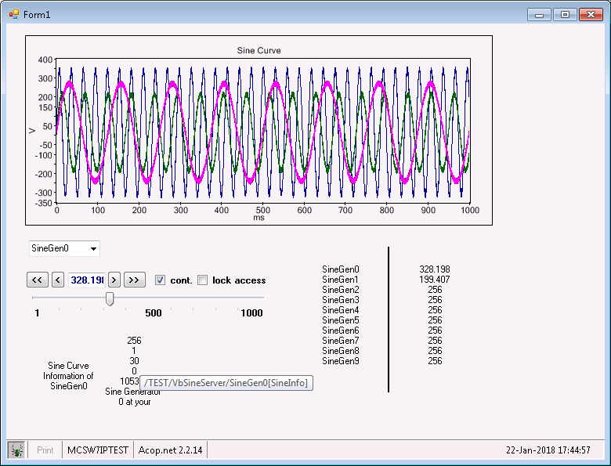
Client talking IPv6 and IPv4 …

Slide 6
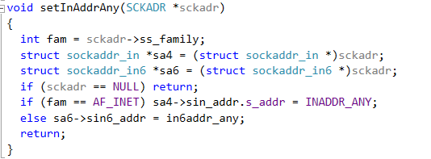

4.6.3 and IPv6
Either use distinct sockets for AF_INET and AF_INET6
or …
Use addr_any and turn IPV6_V6ONLY off !
Same socket handles either kind of traffic …

Slide 7
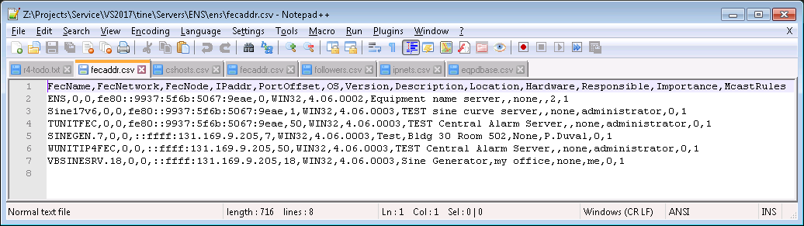
4.6.3 and IPv6
ENS database (running on IPv6) looks like :
IPv4 clients get an IPv4 address
  (without the leading “::ffff:” )
IPv6 clients get an IPv6 address (a real one or a mapped IPv4 address
  (with the leading “::ffff:”)

Slide 8
4.6.3 and IPv6
What to do when a dual-stack IPv6 server registers itself with the ENS ?
  The ENS sees the IPv6 address
  There is no systematic IPv4 address assignment (e.g.) :
    Link-local IPv6 Address . . . . . : fe80::7c89:716f:a87f:38da%11(Preferred)
    IPv4 Address. . . . . . . . . . . : 131.169.9.205(Preferred)
  Proposal:
    do an interface scan and discover the bound IPv6 and IPv4 preferred addresses
    Use IPv6 address (if TINE_IPV6=TRUE) and send the IPv4 address along as well …

Slide 9
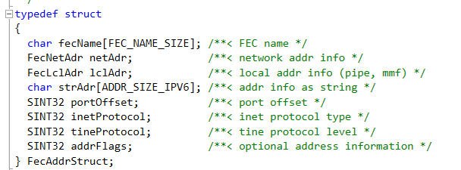
4.6.3 and IPv6
A server sends the ENS the following at startup :
Use the ‘lclAdr’ field (8 free bytes and empty for plug-and-play registration) to carry the IPv4 address info !

Slide 10
4.6.3 and IPv6
Modernize the fecaddr.csv header. Currently:
FecNetwork and FecNode -> IpxAddr and MacAddr
  Once used in the ‘good old days’ of IPX …
IPaddr -> synonym for IPv4addr
IPv6addr => NEW Column !
In the above
  ‘IPaddr’ will be the ‘IPv6Addr’ column
  ‘IPv4Addr will appear and contain e.g. ‘131.169.9.205’ etc.

Slide 11
4.6.3 and IPv6
Java code needs to be tweaked but ‘almost’ works as it is now …
Acop.NET news ?

Slide 12
Still To Do …
Release 5.0 …

