Slide 1
Globals
More than you ever wanted to know …

Slide 2
early HERA days (~1993/1994)
most applications 'needed to know’ :
beam current, beam lifetime, beam energy, machine state, etc. (for P and E)
broadcast these values @ 1 Hz !
Special API calls:
sendNetGlobal()
recvNetGlobal()

Slide 3
This is not Publish/Subscribe !
The Globals server just does it whether anyone is interested or not
No client lists !
Globals packed together (as many as possible) in one ethernet packet
With MTU ~1472 bytes
~ 10 globals per packet

Slide 4
Multicast
~2000 => multicast (and optionally broadcast)
Note: DOS / Win16 IP Stack did not support multicast

Slide 5
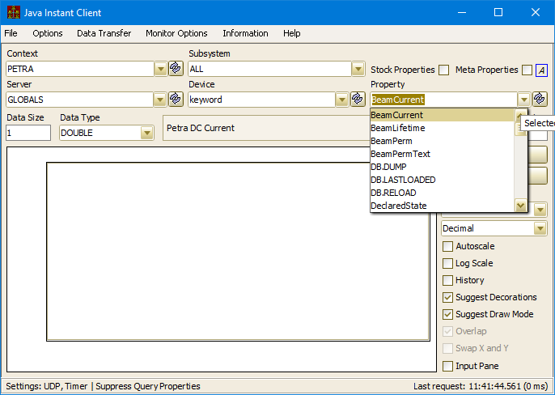
Those pesky developers
Application developers discovered a server called 'GLOBALS' with properties 'BeamCurrent' etc.
Made use of 'normal' API calls AttachLink() or worse: ExecLink() in a loop

Slide 6
COERCION
Getting the troops to make use of recvNetGlobal() is like pulling teeth !
FORGETABOUTIT …
Trap calls to /<Some Context>/GLOBALS/keyword[<some property>]
remap to recvNetGlobal()
If applicable : i.e. get the list of multicasted globals from target Globals server)
i.e. property KEYWORDS is NOT a Globals property
Change any ExecLink() to a ‘listener’

Slide 7
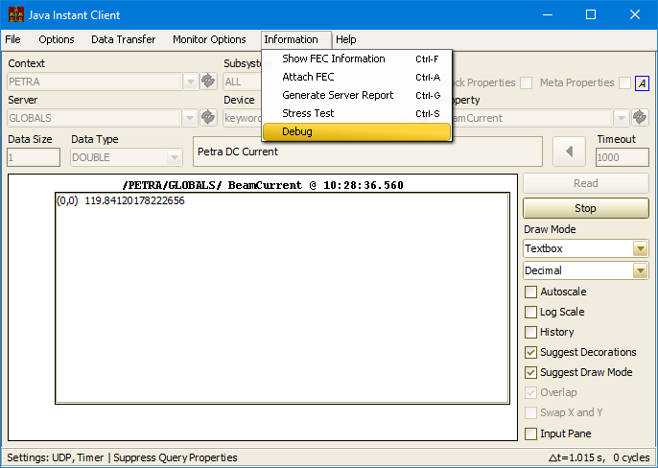
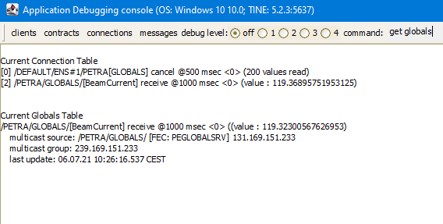
Coercion from the instant client

Slide 8
Other benefits
Initial Globals call
learns the ‘globals’ list
joins multicast group
begins receiving (all) globals packets from Globals server
Additional globals calls
Immediately have and can return to desired parameter value

Slide 9
Globals servers
Standard Globals server :
List of which parameters to obtain
Target servers
Possible fail-over instructions
can have primary and secondary sources for some parameter …
Time Synchronization Server (Release 4.xx and above)
Current time multicasted as global @ one Hz
Cycle Number (Event Number)
Sent as global @ whatever rate (e.g. PETRA chain @ 6.25 Hz, XFEL @ 10 Hz)

