Slide 1
TINE Core Meeting
25.5.2016

Slide 2
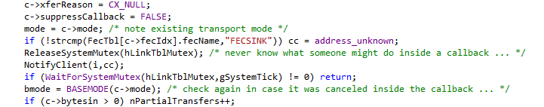
Noteworthy C-Lib Changes
Refactoring (thanks to TANGO)
  Use gIsCyclePollingMode instead of ‘POLLING’, ‘SELECTING’. e.g.
  becomes
linkTbl mutex protection inside checkConnections().

Slide 3
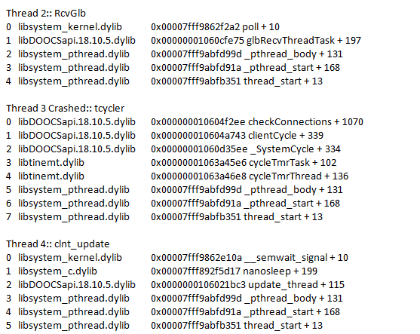
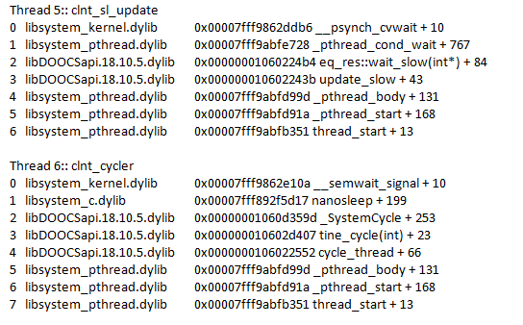
Noteworthy C-Lib Changes
linkTbl mutex protection …
Notice anything ‘suspicious ?

Slide 4
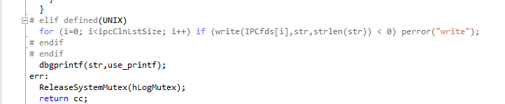
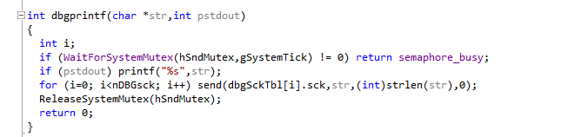
Noteworthy C-Lib Changes
avoid a potential deadlock when debugging is ON and there are send socket errors
  also in this regard: treat 'printf' as a 'send' (as it is on VxWorks).
inside dbglog() :
dbgprintf() :

Slide 5
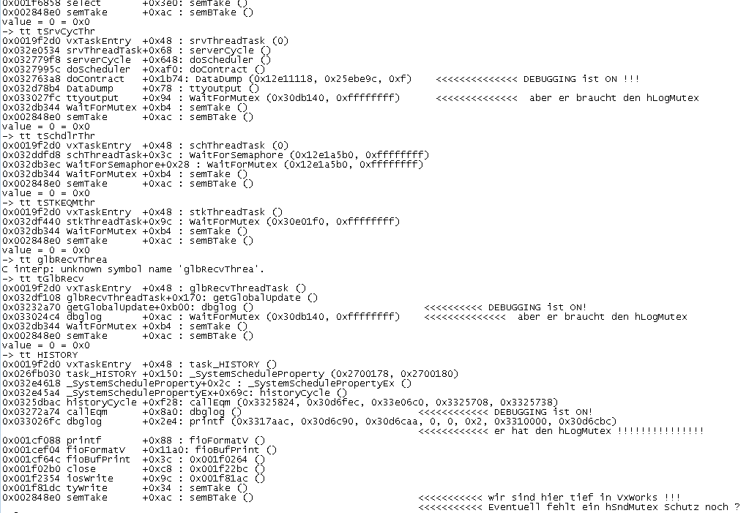
Noteworthy C-Lib Changes
VxWorks ‘task trace ….’

Slide 6
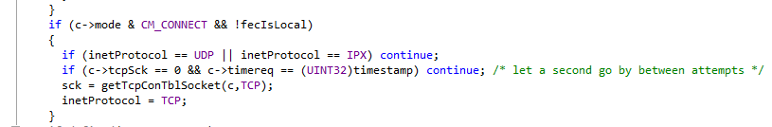
Noteworthy C-Lib Changes
introduce Set/GetSuspendCallbacks()
  e.g. use around calls to ExecLink()
added a 'flush address' and 'flush cache' to the console commands
  To force server address reacquisition ‘now’ !
fixed timereq = 0 in _attachLink so as to avoid long wait in establishing TCP connection
From prepSubRequest()

Slide 7
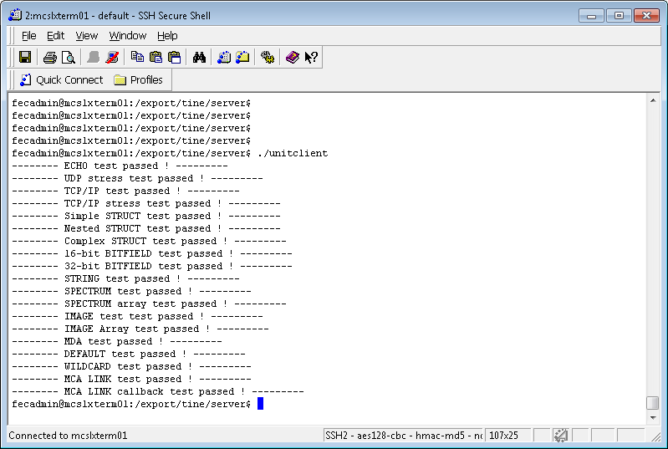
Noteworthy C-Lib Changes
long wait in establishing TCP connection
  Anywhere from 0 to 1000 msec !
  Was not caught by ‘unit server/unit client’
  Now it is!

Slide 8
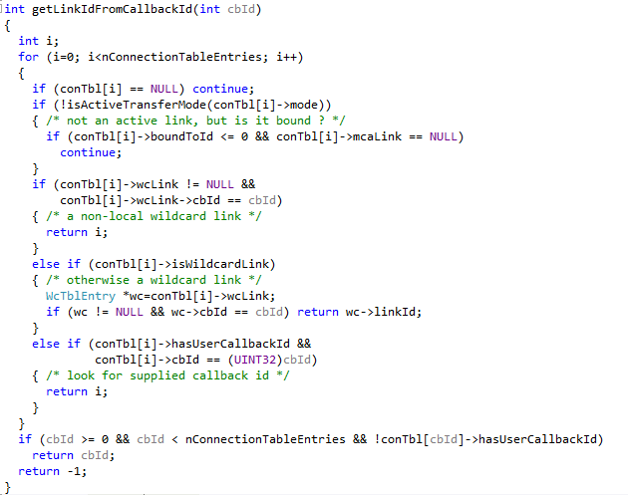
Noteworthy C-Lib Changes
respect the bound and mca links in getLinkIdFromCallbackId()
Necessary addition !

Slide 9
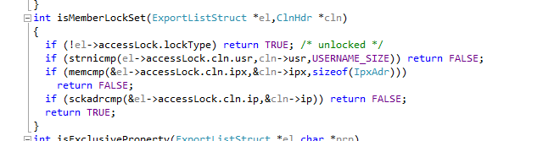
Noteworthy C-Lib Changes
Set/GetPutCommandsInCmdlog() to accompany the new ‘commands.log’
  ‘commands.log’ in addition to ‘fec.log’
add routine sckadrcmp() to replace a memcmp() on a comparison of SCKADR objects used in access lock comparison.

