Slide 1
TINE Core Meeting
28.11.2017

Slide 2
Feature Additions 4.6.2
To do:
  Need a ‘contacts’ server.
    Input: ‘a follower’ or a ‘followers list’
    Output: associated email address(es)
      Check : if ‘follower’ is a FEC then determine the ‘responsible list’
      => a ‘follower’ could resolve to > 1 contact
    Input: “send message to followers”
    Output: determine the contacts list and email the message !
Andreas is working on it !

Slide 3
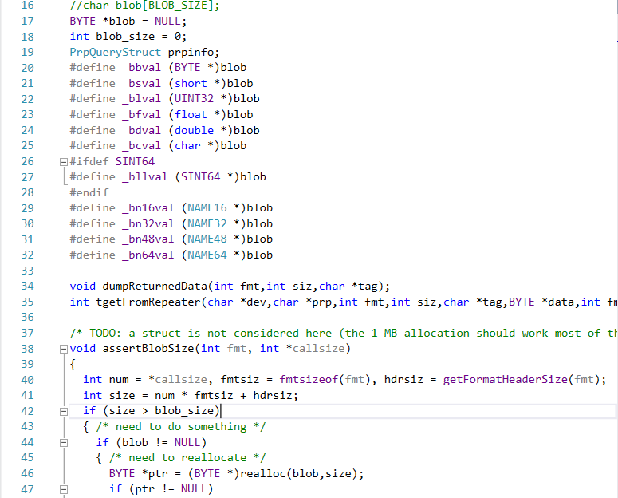
Bug Fixes and Features 4.6.2
Utilities:
  command line: talarms :
    Seg fault when MPI tried to use it …
Resulted from a refactoring of the ‘blob’ working area that the command line tools use :

Slide 4
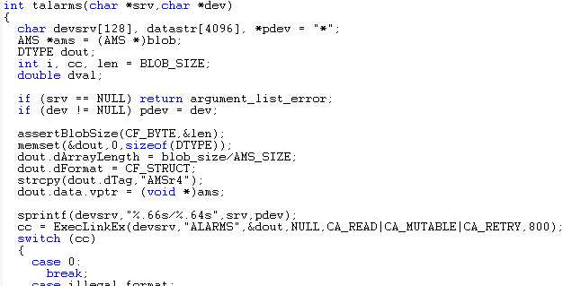
Bug Fixes and Features 4.6.2
Originally:
Oops!

Slide 5
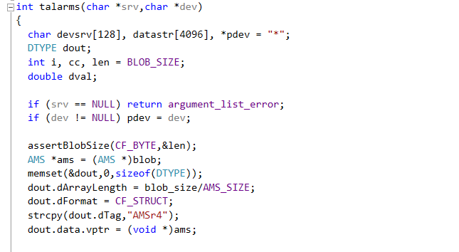
Bug Fixes and Features 4.6.2
First Fix:
Oops! This is C, not C++.

Slide 6
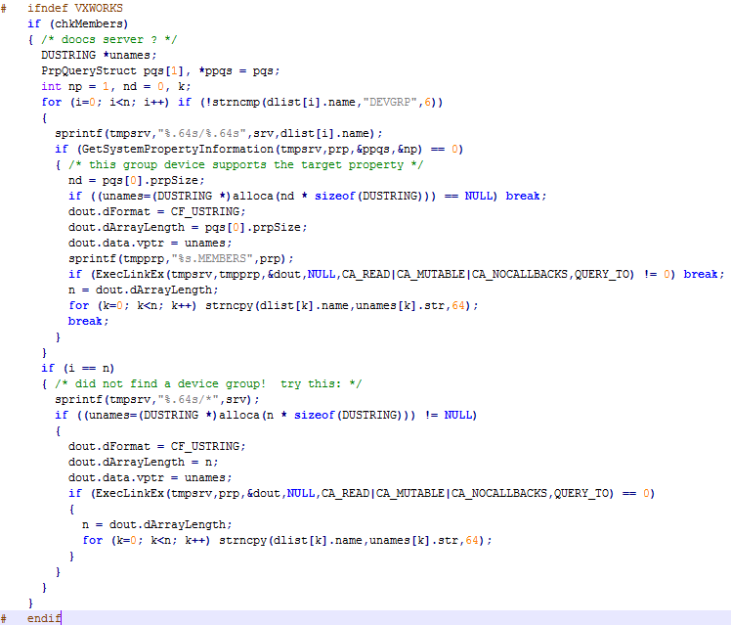
Bug Fixes and Features 4.6.2
Inside ‘GetSystemDevices() :
Try to ‘learn’ channel names from a doocs array :

Slide 7
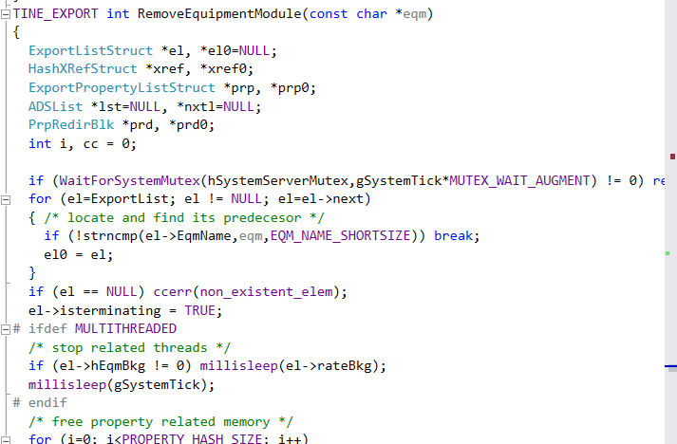
Feature Additions 4.6.2
Extra mutex in RemoveEquipmenModule
  Both FreeEQPModules() and freeServerMemory() call this !
    Was a problem with buffered server attaching to a fec.xml database.

Slide 8
Bug Fixes and Features 4.6.2
Local History tweaks …
  Add a transition point when ‘next’ data point is out of tolerance.
  Trap a M. Lomperski crazy setting:
    Long-term history depth = 1200 (because he always wants to keep it around)
    1200 months = 100 years -> file name naming system using the last two YY characters sees ’17’ which is ‘this year’.
    => don’t allow local history > 20 years !

Slide 9
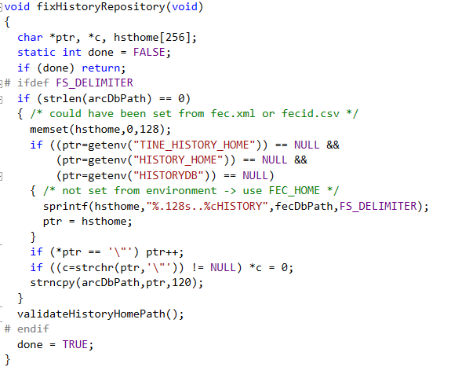
Bug Fixes and Features 4.6.2
Local History tweaks …

Slide 10
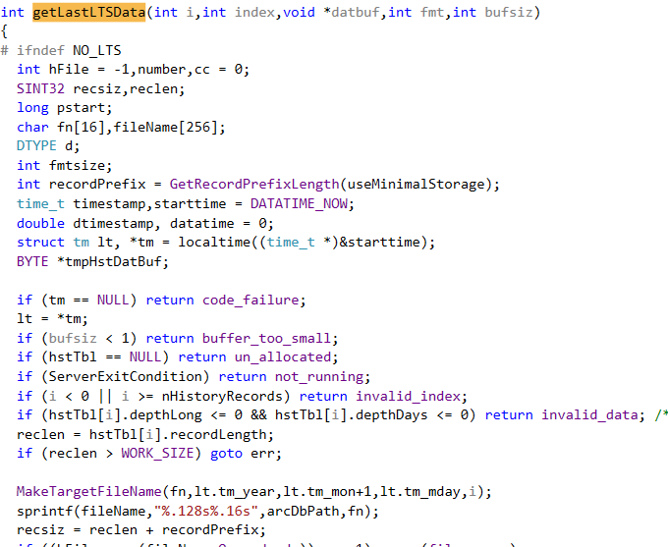
Bug Fixes and Features 4.6.2
Local History tweaks …
Filename refers to ‘today’

Slide 11
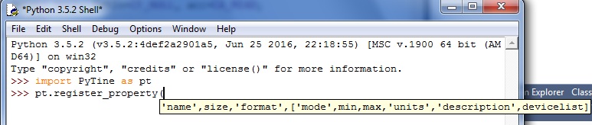
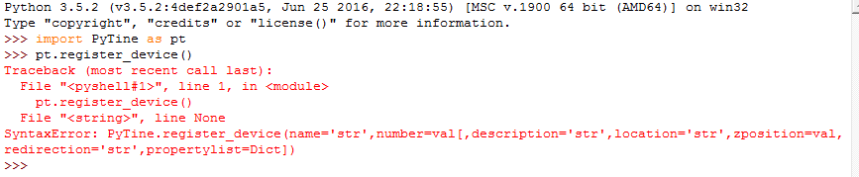
Feature Additions 4.6.2
Python (server API) …
  add ‘lists’ to property and device registration …

Slide 12
Feature Additions 4.6.2
Python (3.5):
  32-bit windows PyTine.pyd (for KEK)

Slide 13
Feature Additions 4.6.2
Master/Slave
  failover slaves now signal the master to re-export modules if it appears to have been simply unresponsive
    New stock property ‘REEXPORT’
  New API calls to determine if ‘I’m a slave who is now running as master’
    New stock property “FAILOVERSTATE”
    API :

Slide 14
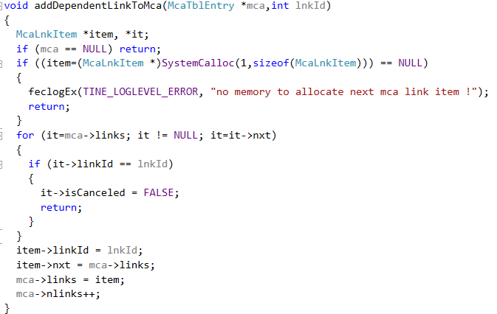
Feature Additions 4.6.2
Bug(s) of the month …
  If we find it in the list during an ‘add’ make SURE it’s not canceled!

Slide 15
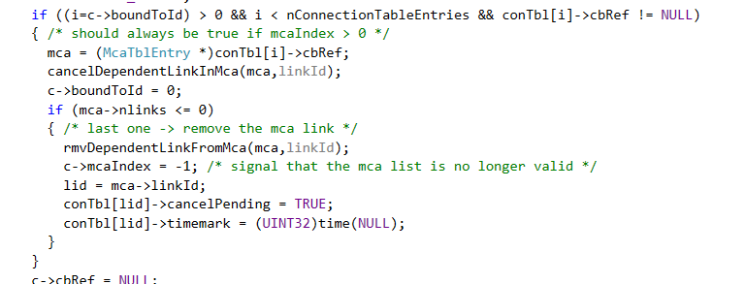
Feature Additions 4.6.2
Bug(s) of the month …
  in _closeLink() …

Slide 16
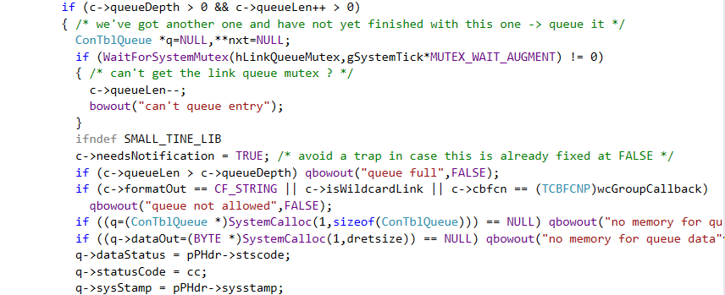
Feature Additions 4.6.2
Bug(s) of the month …
  link queues : (don’t allow if we’re accessing a true string) …

Slide 17
Feature Additions 4.6.2
Many new Acop.NET controls
Fixes and features in tine.NET DLL.
…

Slide 18
Still To Do …
IPv6 testing
Release 5.0 …

